Slide 1



26 – 28 April 2026
São Paulo, Brazil

Slide 2
SALES DECK
RAW SPACE
REGULAR – USD 190/sqm – until 31/12/2025
LATE BOOKING – USD 260/sqm – from 01/01/2026
Fees and taxes not included
• Grey carpet
• Wooden walls 2.00h
• Signboard with the company logo
• 1 Table
• 3 Chairs
• 2 Hangers or 2 Shelves
• 1 Spotlight - 1 per 3sqm
• 1 Power Plug
SHOW ONE
USD 250/sqm

Slide 3
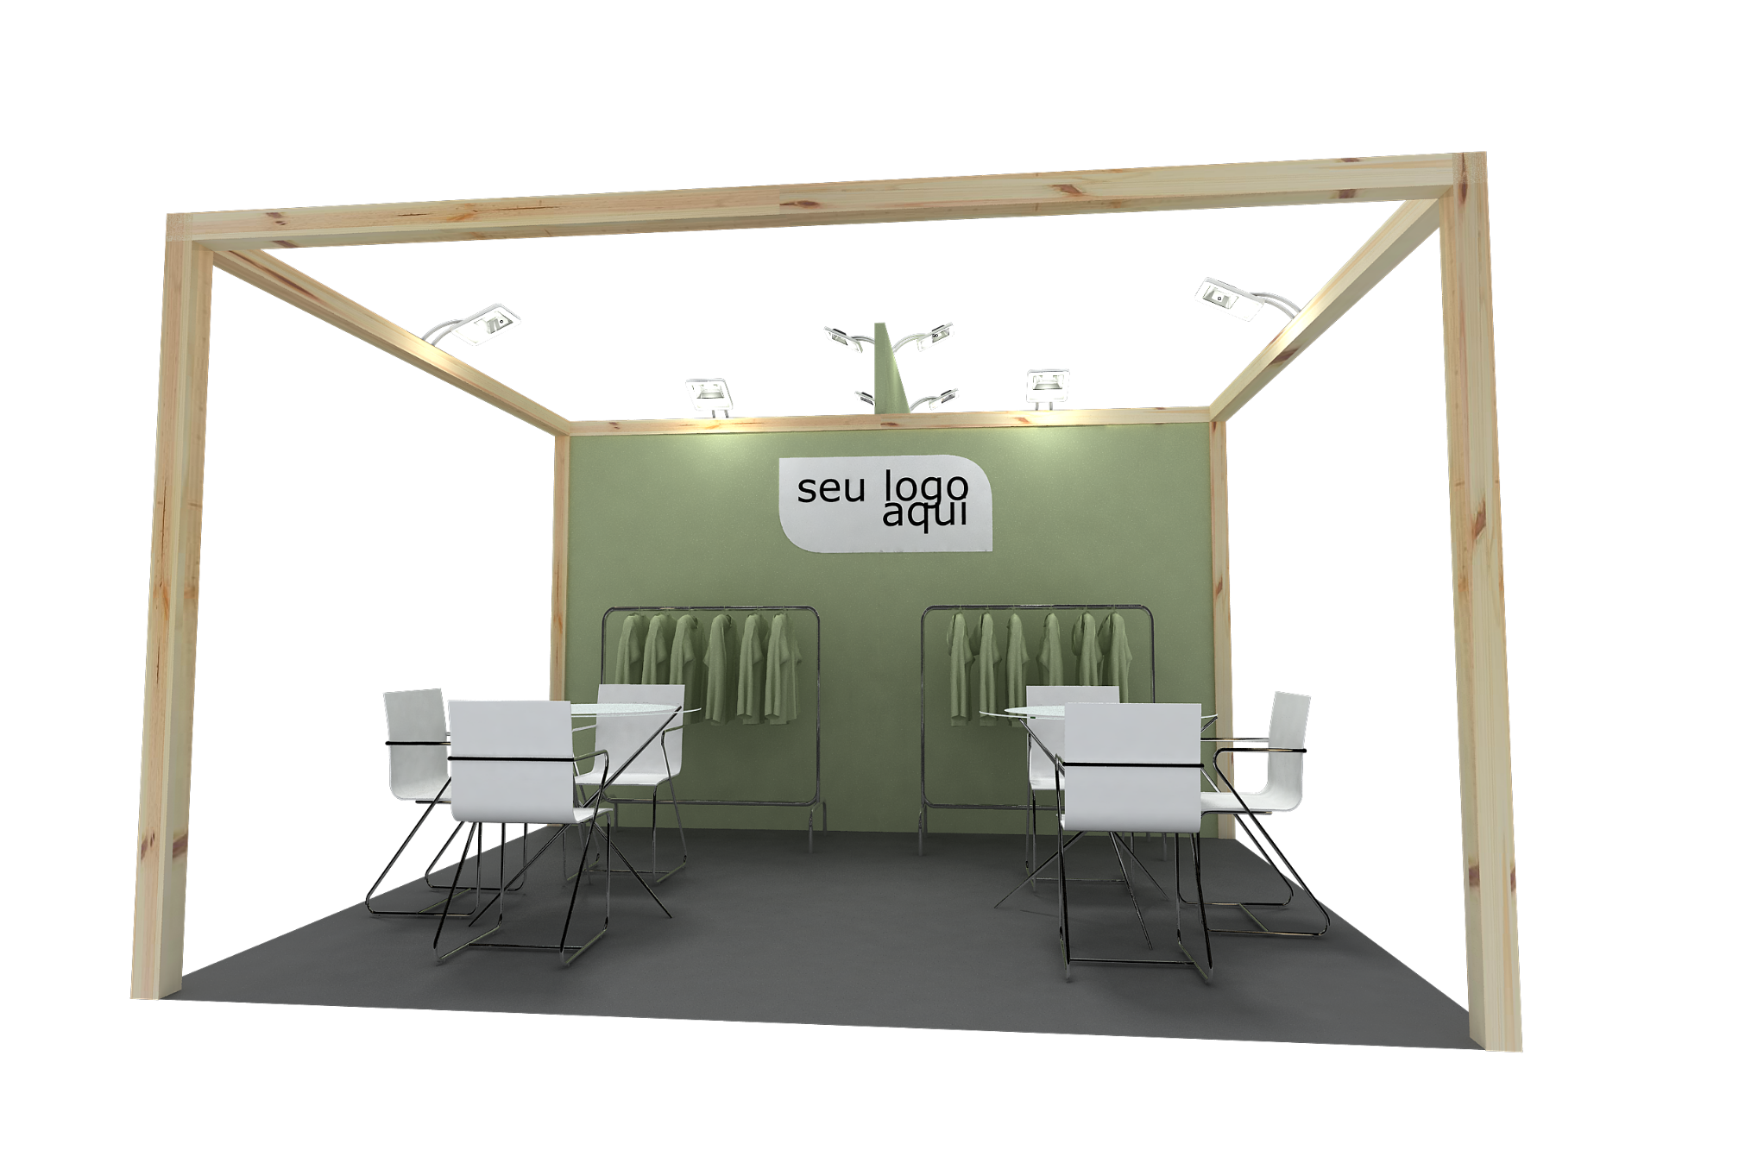
SALES DECK
SHOW ONE - TURNKEY PACKAGE
your logo here
Image for illustrative purposes
3x4 – 12cqm – 3 sides open

Slide 4
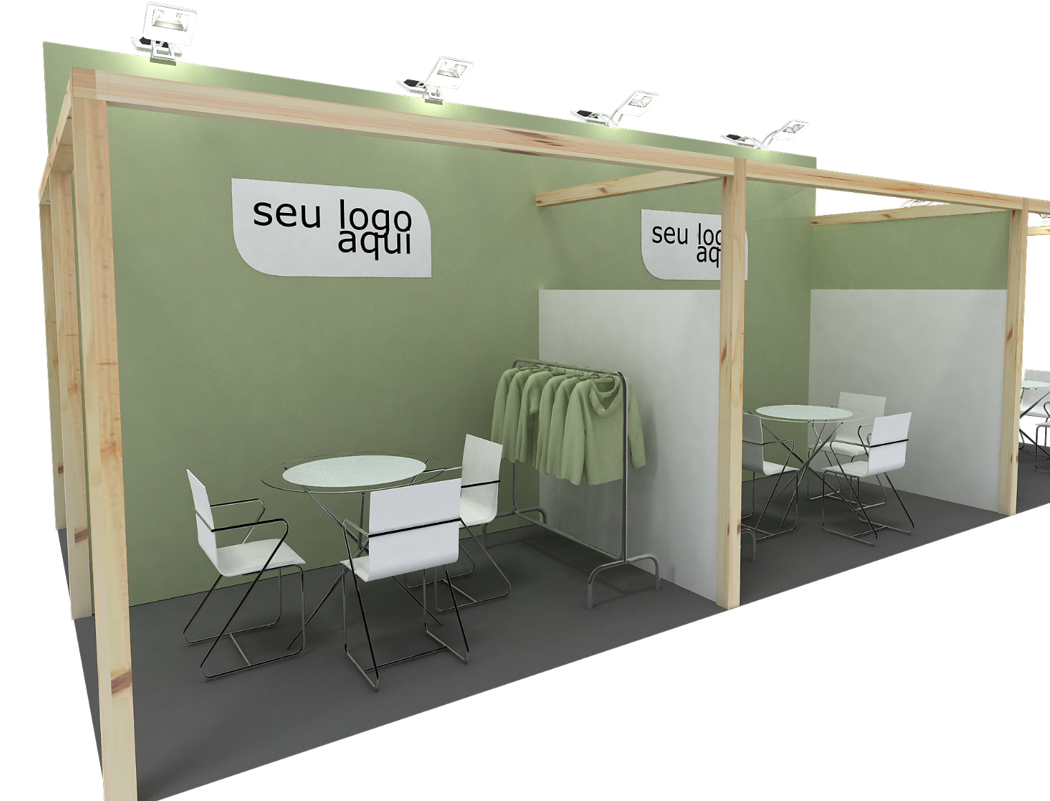
SALES DECK
SHOW ONE - TURNKEY PACKAGE
your logo here
3x4 – 12sqm - corner
Image for illustrative purposes

Slide 5
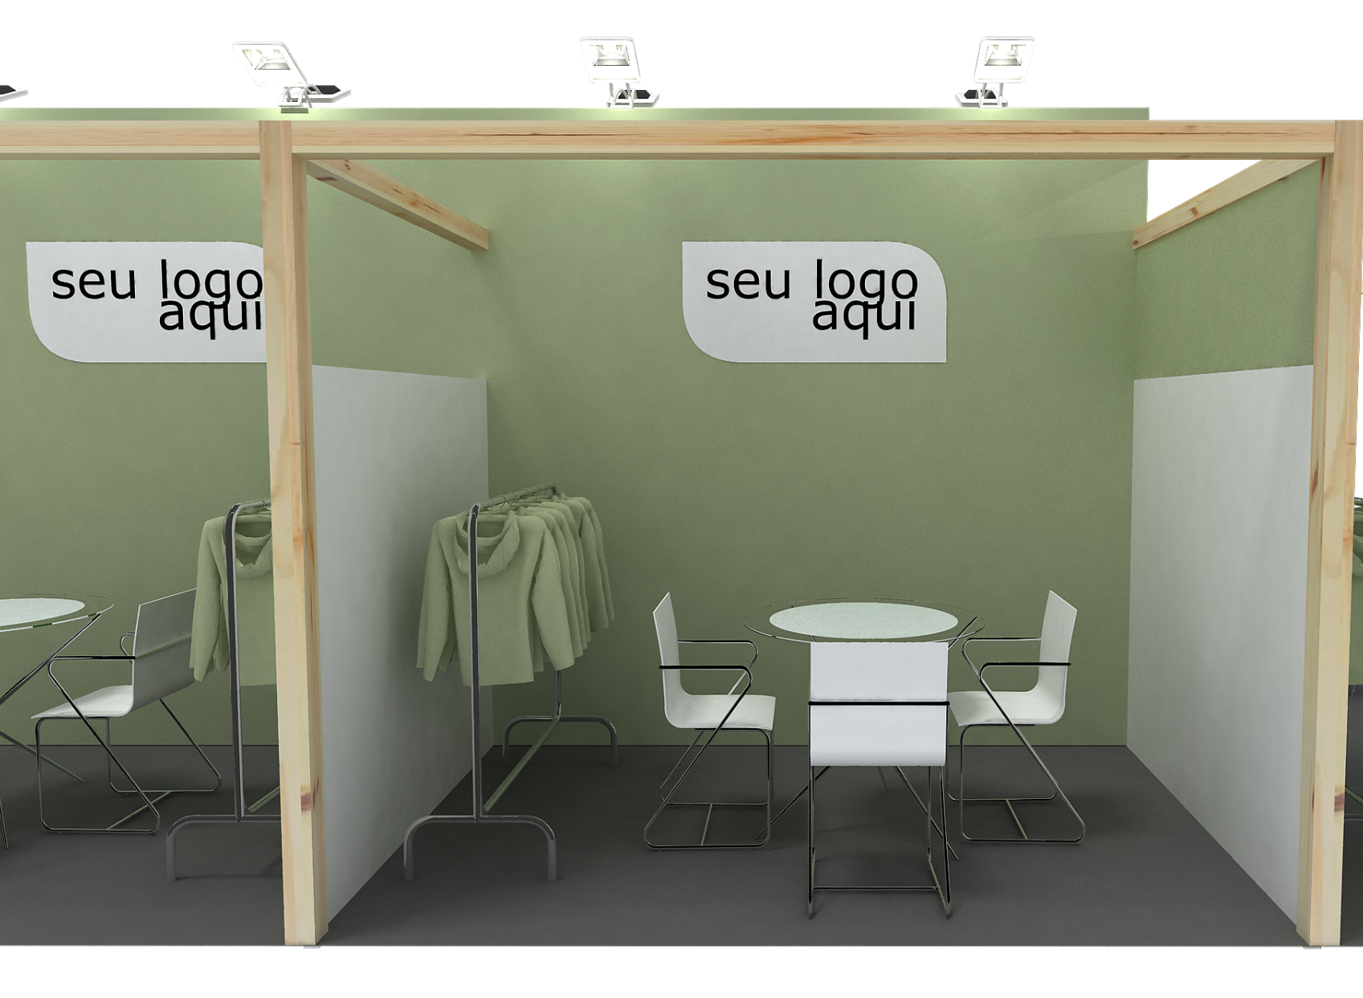
SALES DECK
SHOW ONE - TURNKEY PACKAGE
3x3 – 9sqm with 3 walls
your logo here
Image for illustrative purposes

