Slide 1



26 – 28 April 2026
São Paulo, Brazil

Slide 2
SALES DECK
RAW SPACE
REGULAR – USD 202/sqm – until 31/12/2025
LATE BOOKING – USD 235/sqm – from 01/01/2026
Fees and taxes not included
• Grey carpet
• Octanorm walls 2.75h
• Signboard with the company logo
• 1 Table, 3 Chairs, 2 Shelves, 1 Counter
• 1 Spotlight - 1 per 3sqm
• 1 Power Plug
• 1x1m Storage
COMFORT SHELL SCHEME
USD 132/sqm

Slide 3
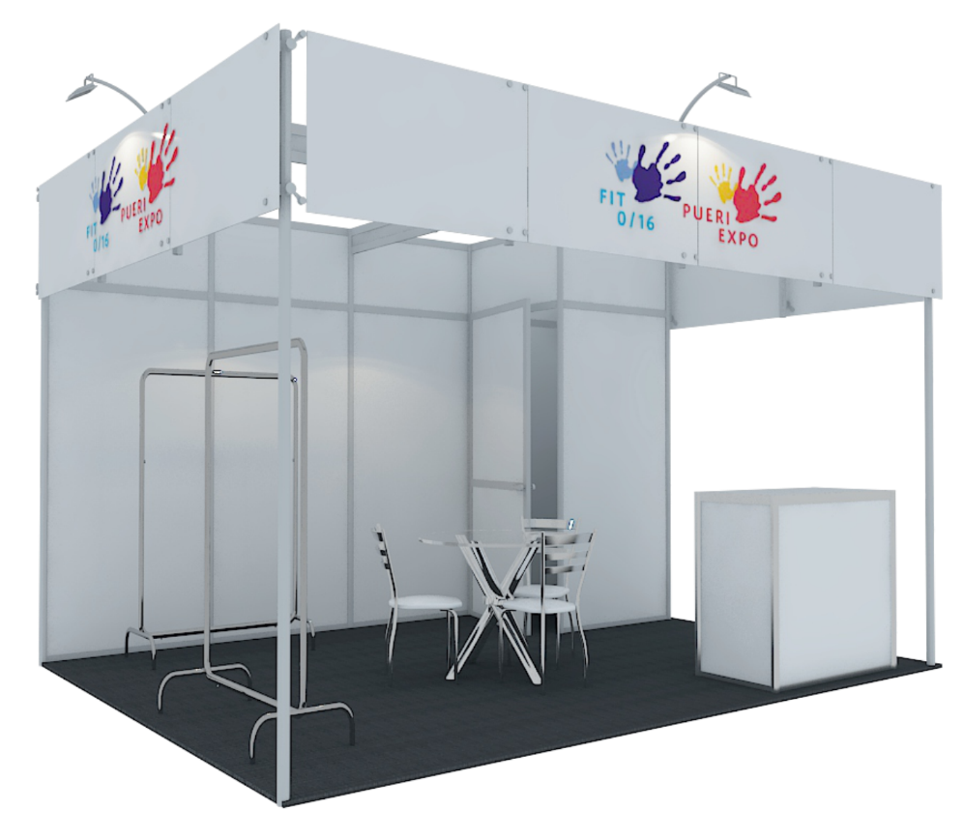
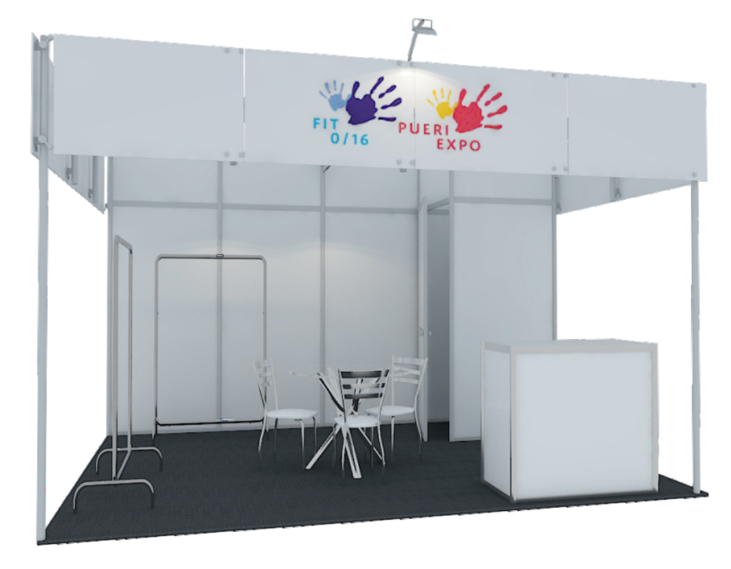
SALES DECK
COMFORT SHELL SCHEME
Comfort shell scheme – 3x4 – 12sqm
Image for illustrative purposes

